Slide 1
Chapter 9 IGMP and MLD
IGMP-Internet Group Management Protocol
  is a communications protocol used by hosts and adjacent routers on IPv4 networks to establish multicast group memberships
  IGMP is an integral part of IP multicast
  One to many applications such as gaming, streaming video
  Separate transport layer protocol!
    Examples are sending an email to a mailing list
    Teleconferencing or videoconferencing

Slide 2
Chapter 9 IGMP and MLD
MLD – Multicast Listener Discovery
  Manages multicast on IPv6 networks
  Part of ICMPv6
  Used to discover multicast listeners directly attached
  Sent with a link local IPv6 source address
  IPv6 hop limit of 1
  Remember that routers do not bother with multicast addresses thus the limit of 1 on the hop count
  Uses ICMPv6 message types 130, 130, 132

Slide 3
Chapter 9 IGMP and MLD
MLD – Multicast Listener Discovery (3 types of messages)
  130 is the Multicast Listener Query
  131 is the Multicast Report
  132 is the Multicast Listener Done

Slide 4
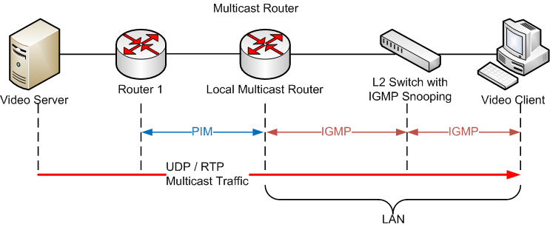
Chapter 9 IGMP and MLD
  IGMP

Slide 5
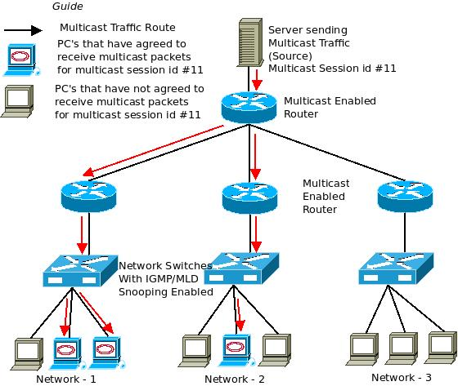
Chapter 9 IGMP and MLD
  MLD

Slide 6
Chapter 9 IGMP and MLD
  A node sends the Multicast Listener Report and Done messages to the multicast groups of which the node is already a member

Slide 7
Chapter 9 …..MLD
  An IPv6 multicast group is an arbitrary group of receivers that want to receive a particular data stream. This group has no physical or geographical boundaries.
    Receivers can be located anywhere on the Internet or in any private network
  Receivers that are interested in receiving data flowing to a particular group must join the group by signaling their local device.
    This signaling is achieved with the MLD protocol

Slide 8
Chapter 9 MLD
  Devices use the MLD protocol to learn whether members of a group are present on their directly attached subnets
  Hosts join multicast groups by sending MLD report messages
  The network then delivers data to a potentially unlimited number of receivers, using only one copy of the multicast data on each subnet
  IPv6 hosts that wish to receive the traffic are known as group members.

Slide 9
Chapter 9 MLD
  Packets delivered to group members are identified by a single multicast group address
  The multicast environment consists of senders and receivers. Any host, regardless of whether it is a member of a group, can send to a group. However, only the members of a group receive the message
  Membership in a multicast group is dynamic!
  There are no restrictions on the location or number of members

Slide 10
Chapter 9 MLD
  MLD query… 130
    In a query message, the multicast address field is set to 0 when MLD sends a general query
    The general query learns which multicast addresses have listeners on an attached link.

Slide 11
Chapter 9 MLD
  MLD Report – 131
    In a report message, the multicast address field is that of the specific IPv6 multicast address to which the sender is listening

Slide 12
Chapter 9 MLD
  MLD Done – 132
    In a done message, the multicast address field is that of the specific IPv6 multicast address to which the source of the MLD message is no longer listening

Slide 13
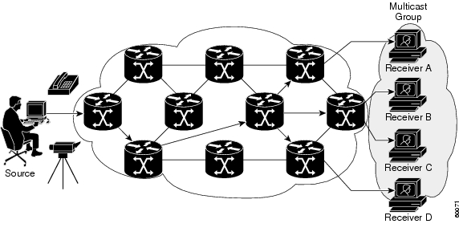
Chapter 9 IGMP
The receivers (the designated multicast group) are interested in receiving the video data stream from the source. The receivers indicate their interest by sending an Internet Group Management Protocol (IGMP) host report to the routers in the network

Slide 14
Chapter 9 IGMP
  Multicast is based on the concept of a group
  Hosts that are interested in receiving data flowing to a particular group must join the group using IGMP
  IANA has assigned the IPv4 Class D address space to be used for IP multicast
  All IP multicast group addresses fall in the range from 224.0.0.0 through 239.255.255.255

Slide 15
Chapter 9 IGMP
  This presents a problem on NIC’s bescause a LAN segment could receive only packets destined for their burned-in MAC address or the broadcast MAC address
  A method had to be accomplished to allow this……
  Mapping an IP multicast Class D addresses directly to a MAC address. Today, using this method, NICs can receive packets destined to many different MAC addresses—their own unicast, broadcast, and a range of multicast addresses.

Slide 16
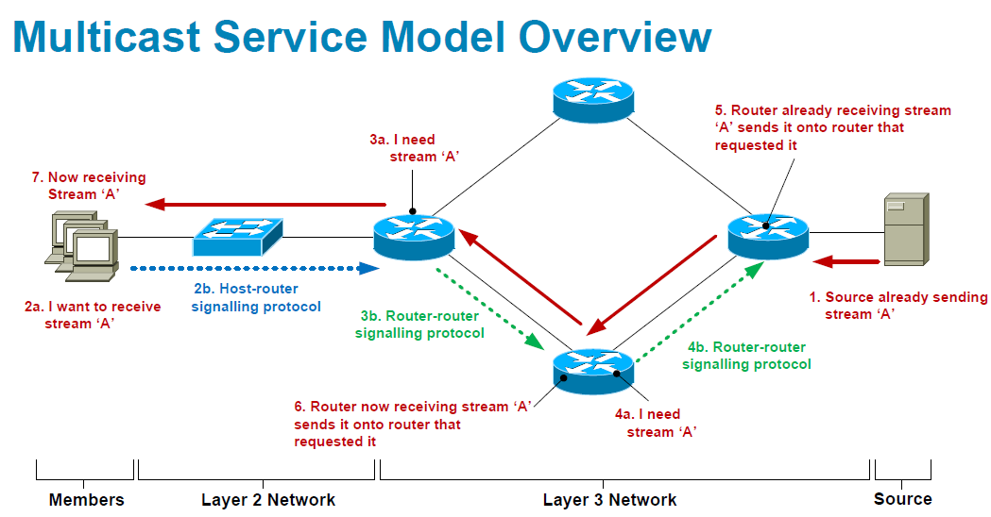
Chapter 9 IGMP

Slide 17
Chapter 9 IGMP
Three versions of IGMP
  IGMPv1
  IGMPv2
  IGMPv3
  IGMPv2 is the most common version

Slide 18
Chapter 9 IGMP
Version 1 - main goal was to introduce a query-response system. This system would be used to specify which devices on a network segment were configured to receive data that was being sent to multicast groups.
Version 2 - greatly improved latency issues that existed in IGMP version 1. IGMP version 2 also implemented additional features, which include a leave process, group-specific queries, and an explicit maximum query response time.
Version 3 - further extended the capabilities of the protocol by allowing source filtering, which means that the routers are actually informed as to which sources the traffic is expected from.
Some consider that there is a version 4 we are only using 3 versions!

Slide 19
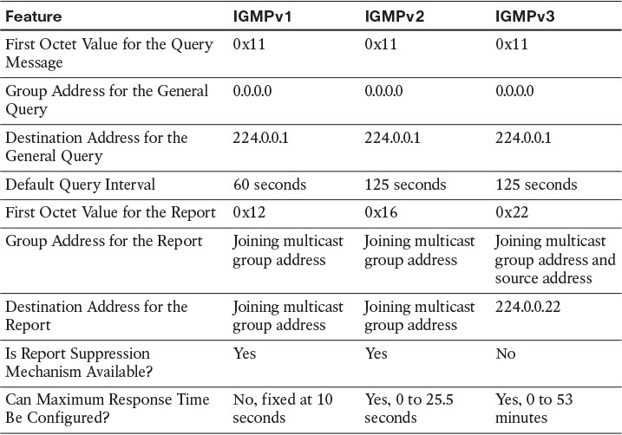
Chapter 9 IGMP

Slide 20
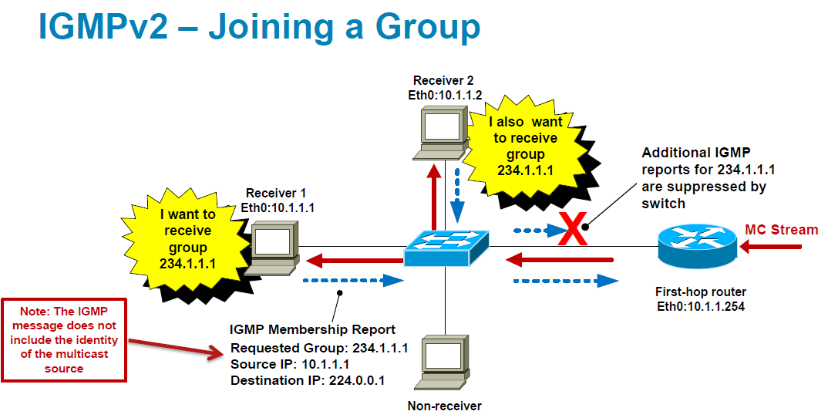
Chapter 9 IGMP

Slide 21
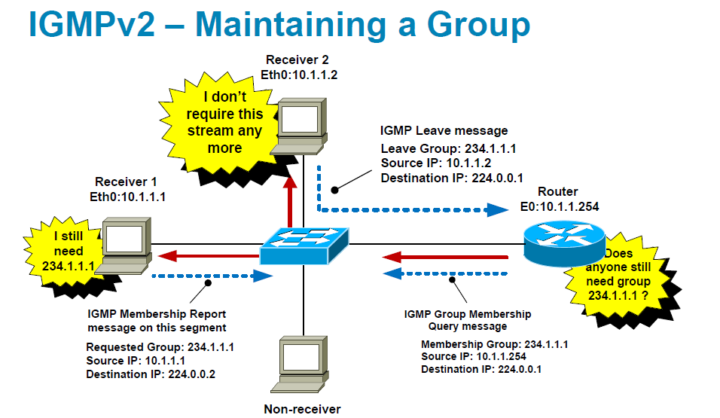
Chapter 9 IGMP

Slide 22
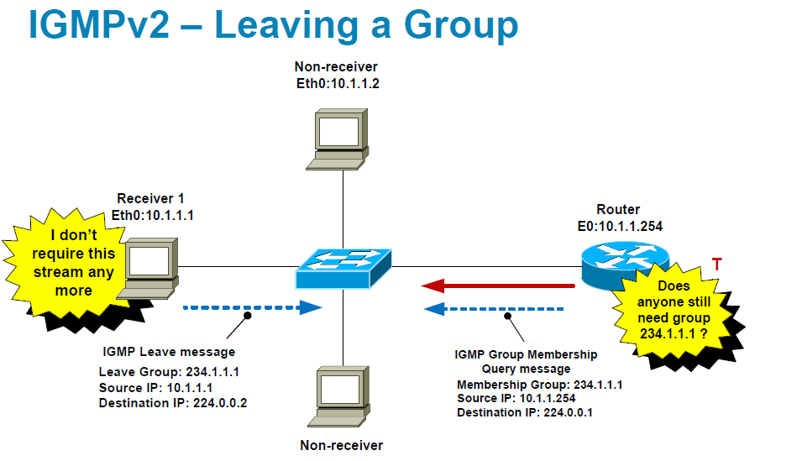
Chapter 9 IGMP

